Slide 1
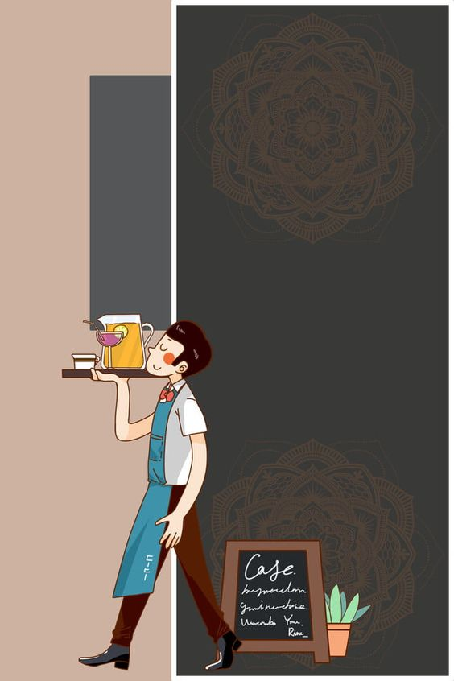
ARoma Cuisine
“ A Unique Dining Experience with Augmented Reality ”
Shovan Kanti Mondal ID-22166005
Nisat Islam Mozumder ID- 22366047

Slide 2
Abstract
The ARoma Cuisine project is to create an augmented reality (AR) restaurant menu application that allows customers to view visually appealing Menu page with food items in a more immersive way. Users can see the 3D model of the food items through the AR system from smartphone or tablet.Thus they can see the ingredient details, allergens , nutrition value and make choices before placing an order. Users can review and give ratings through the application.
17-05-2023

Slide 3
Objective
This project's primary goal is to improve the customer experience by offering a more entertaining and dynamic method to browse a restaurant menu with augmented reality. Customers will be able to see the actual serving size of the meal on the menu, a 360-degree augmented model of those selected menu item, photos and more details about each dish.
17-05-2023

Slide 4
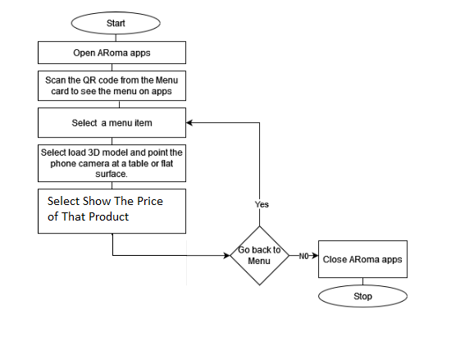
Workflow Diagram
17-05-2023

Slide 5
Methodology
Requirement Gathering
Design
Development
Testing and Iteration
Deployment
17-05-2023

Slide 6
Result
17-05-2023

Slide 7
Conclusions and Future work
17-05-2023

Slide 8
References
Chaurasiya, A. , Mhatre, S. , Chaudhari,R. , Pawar, P.(2019).SMART RESTAURANT MENU CARD BY USING AUGMENTED REALITY. Journal of Emerging Technologies and Innovative Research (JETIR), 6(3),104-106. DOI:*SMART RESTAURANT MENU CARD BY USING AUGMENTED REALITY (jetir.org)
Mali, C., Patil, P.,Mahajan, S., Pardeshi, P.(2021).Restaurant Menu Card by Using Augmented Reality. International Journal of Research in Engineering and Science(IJRES) , 9(12), 26-29. DOI:E09122629.pdf (ijres.org)
Doan, H.(2022). IMPROVING ONLINE RESTAURANT MENU USING AUGMENTED REALITY. Scholarworks.calstate.edu. Improving Online Restaurant Menu Using Augmented Reality (calstate.edu)
G. Margetis, D. Grammenos, X. Zabulis, and C. Stephanidis, “IEat: An interactive table for restaurant customers’ experience enhancement,” in Communications in Computer and Information Science, ser. Communications in compute and information science, Berlin, Heidelberg: Springer Berlin Heidelberg, 2013,pp. 666–670.
“Avant l’app ́etit: An augmented reality interactive menu that elevates the gourmet food experience,” Ph.D. dissertation, 2017.
17-05-2023

Slide 9
Thank You
17-05-2023

